Slide 1

PYTHON DATA ANALYSIS PROJECT
Diabetes Risk Analysis
From data cleaning to insights and practical health recommendations

Slide 2




AGENDA
Project Roadmap
Understanding the Data
An overview of the diabetes risk dataset and its core columns
Data Cleaning
Handling missing values, duplicates, and fixing data types
Analysis & Visualization
Eight analytical questions, each answered with its own chart
Health Recommendations
Practical tips to lower the risk of developing diabetes

Slide 3

01
Understanding the Data
An overview of the diabetes risk dataset and its core columns
Diabetes Risk Analysis

Slide 4
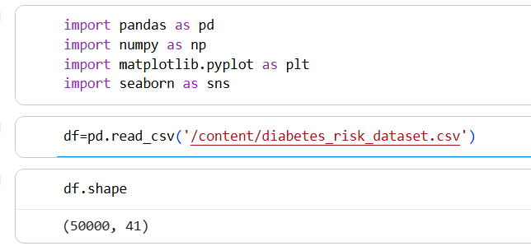
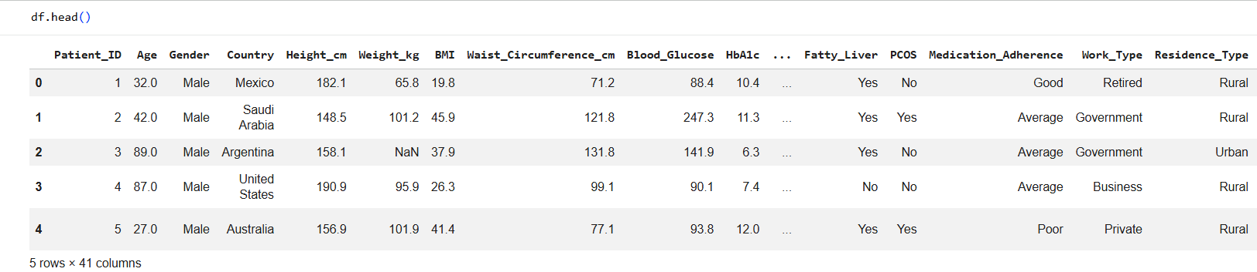
Import Libraries :
Shape of data :
Show a sample of data :

Slide 5
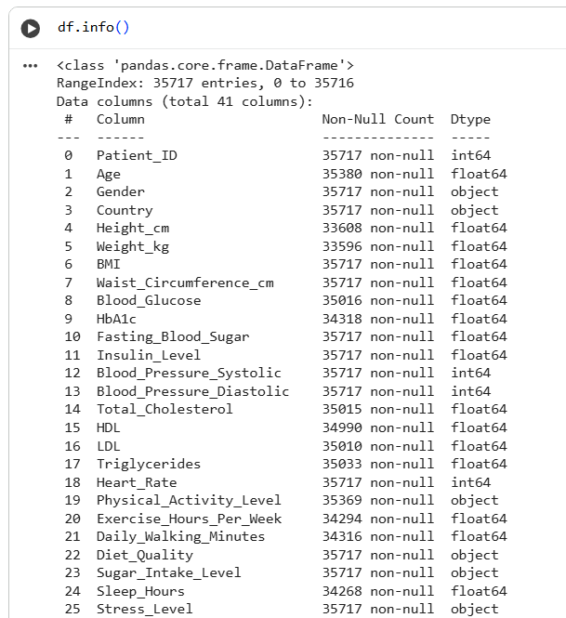
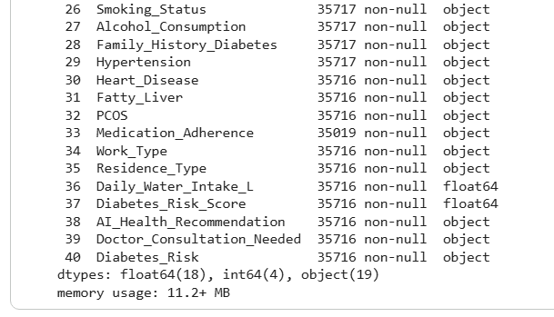
Information about data

Slide 6
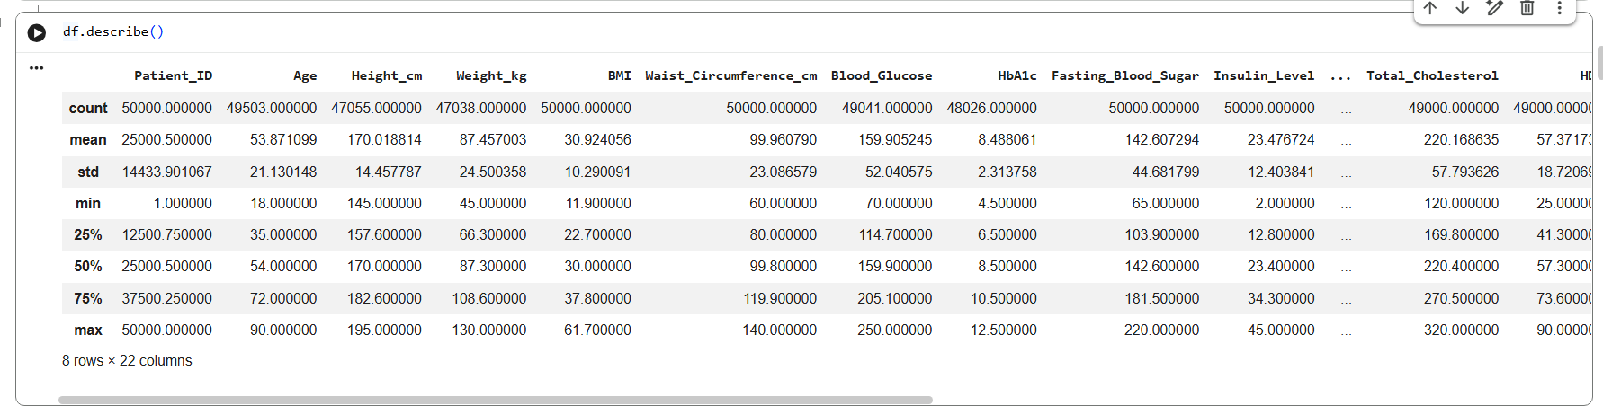
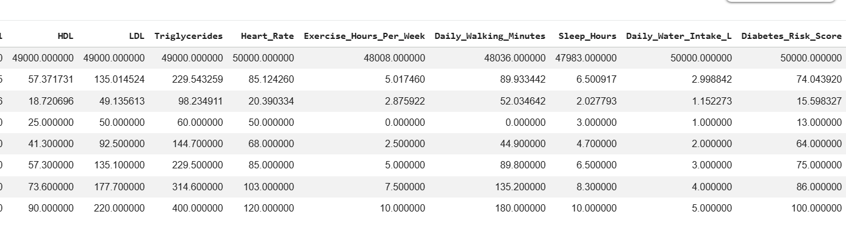

Describe the numerical data

Slide 7



ABOUT THE DATA
About the Dataset
A realistic medical dataset built to assess diabetes risk in patients, combining biometric measurements, demographic data and lifestyle habits, and ending with each patient classified into a risk level (Low / Moderate / High).
50,000
Core Profile
Medical Indicators
Patient rows
Patient_ID . Age . Gender . Country . Height_cm . Weight_kg . BMI . Waist_Circumference_cm . Work_Type . Residence_Type
Blood_Glucose . HbA1c . Fasting_Blood_Sugar . Insulin_Level . Blood_Pressure_Systolic . Blood_Pressure_Diastolic . Total_Cholesterol . HDL . LDL . Triglycerides . Heart_Rate . Family_History_Diabetes . Hypertension . Heart_Disease . Fatty_Liver . PCOS . Medication_Adherence
41
Columns
Lifestyle
Target Variable
3
Physical_Activity_Level . Exercise_Hours_Per_Week . Daily_Walking_Minutes . Diet_Quality . Sugar_Intake_Level . Sleep_Hours . Stress_Level . Smoking_Status . Alcohol_Consumption . Daily_Water_Intake_L
Diabetes_Risk_Score . AI_Health_Recommendation . Doctor_Consultation_Needed . Diabetes_Risk
Risk categories

Slide 8
02
Data Cleaning
Preparing the dataset so it's ready for analysis
Diabetes Risk Analysis

Slide 9
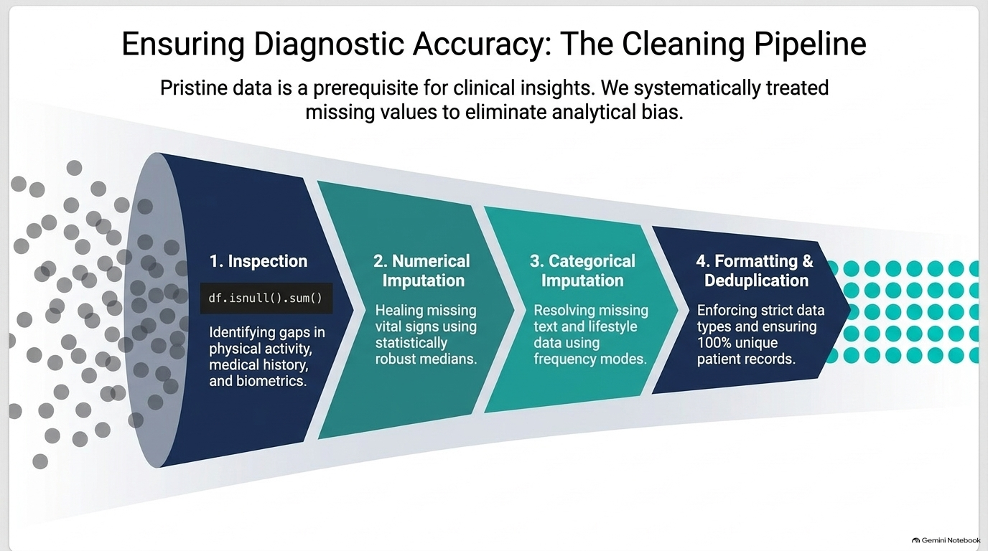

Slide 10
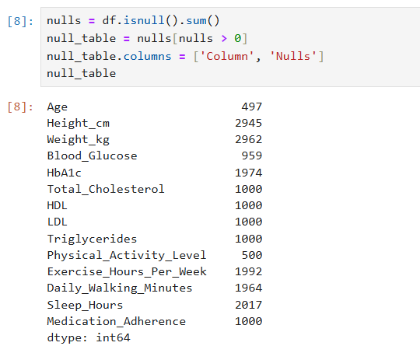

Cleaning Step 1: Show Missing Values

Slide 11
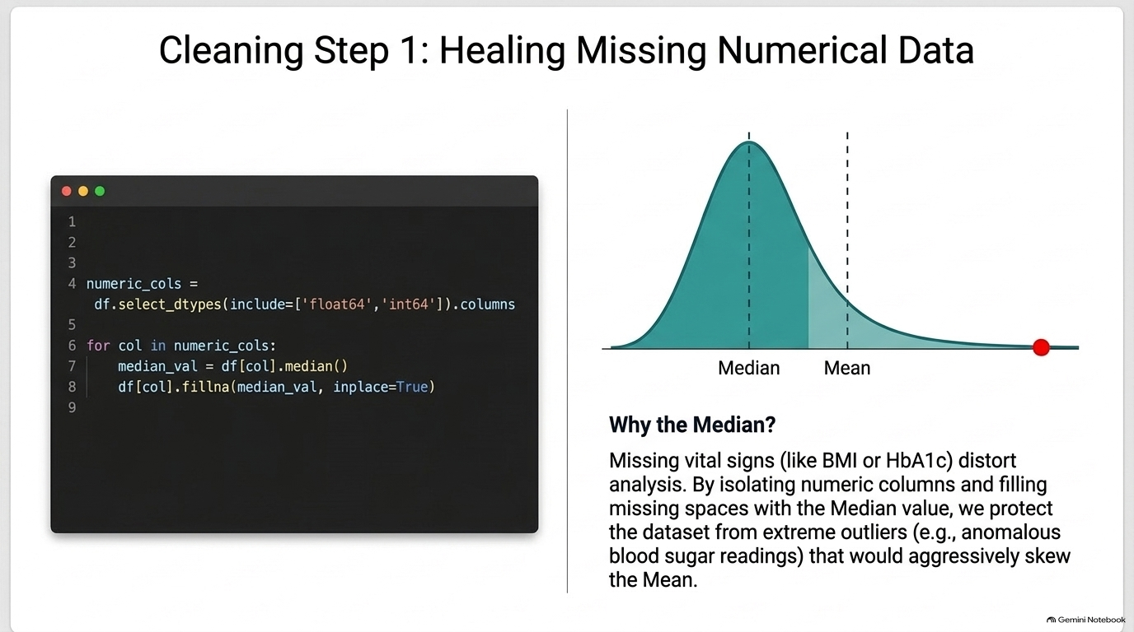
2

Slide 12
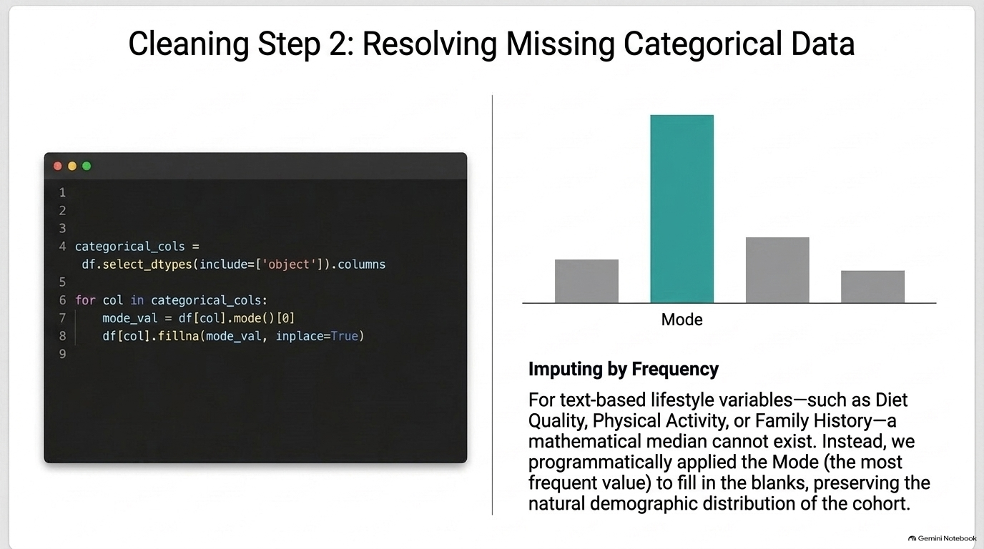
3

Slide 13
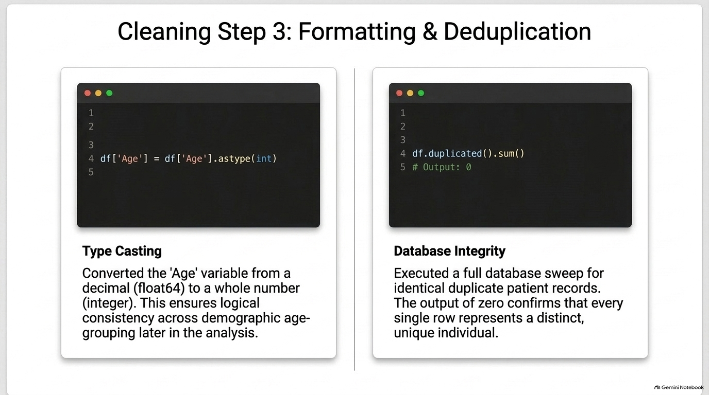
4

Slide 14
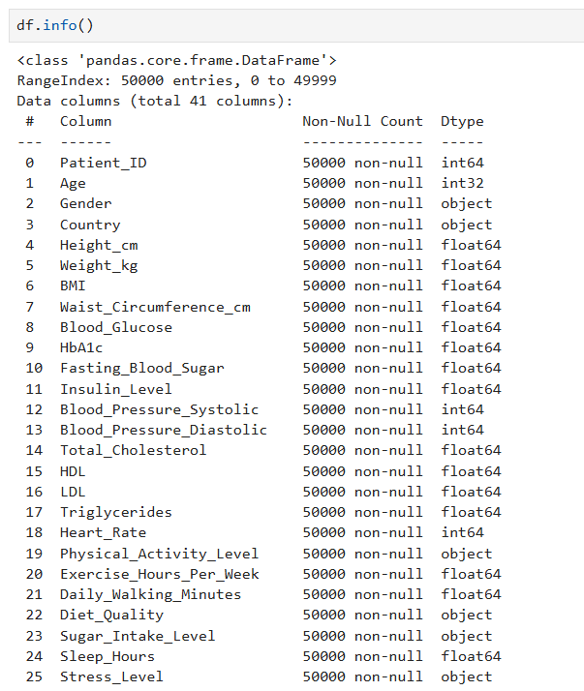
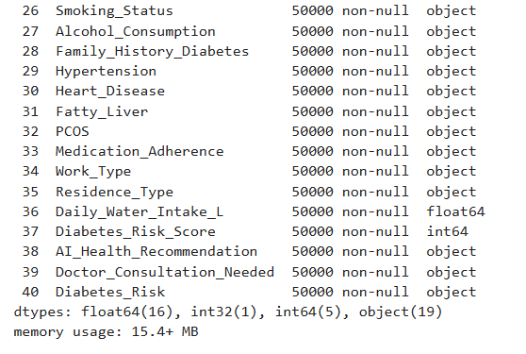
Information about cleaned data

Slide 15

03
Analysis & Visualization
One analytical question per chart, plus the exact code behind it
Diabetes Risk Analysis

Slide 16
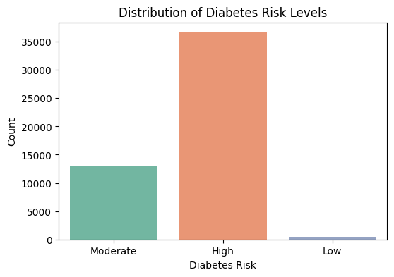

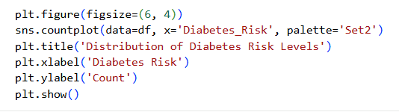
ANALYSIS & VISUALIZATION · Q1
What is the distribution of diabetes risk levels among patients?
Key Insights
The High risk class dominates by a wide margin — about 36,700 patients.
The Moderate risk class has about 13,000 patients.
The Low risk class is very rare — fewer than 500 patients.

Slide 17
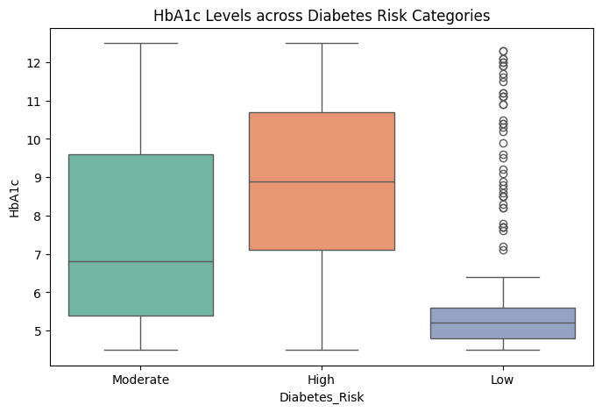
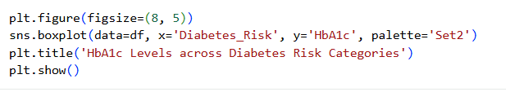
ANALYSIS & VISUALIZATION · Q2
How does HbA1c (average blood sugar) differ across risk levels?
Key Insights
Median HbA1c rises clearly with risk level: ~5.2% for Low, ~6.8% for Moderate, and ~8.9% for High.
Low risk patients show the tightest spread, while Moderate and High are more variable.
This confirms HbA1c as one of the strongest indicators of diabetes risk.

Slide 18
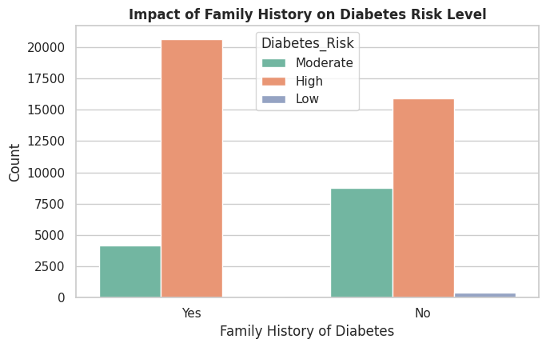
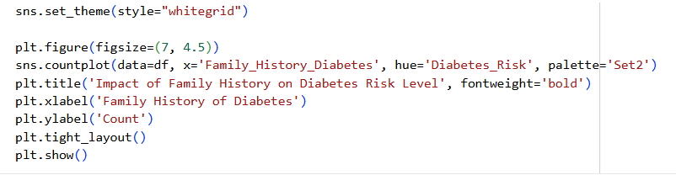
ANALYSIS & VISUALIZATION · Q3
Does a family history of diabetes increase the risk level?
Key Insights
Among patients with a family history (Yes), the High risk class almost completely dominates over Moderate.
Among those without one (No), High is still the largest group, but Moderate is relatively bigger, with a few Low cases appearing.
A family history acts as an additional factor that raises the likelihood of landing in the High risk group.

Slide 19
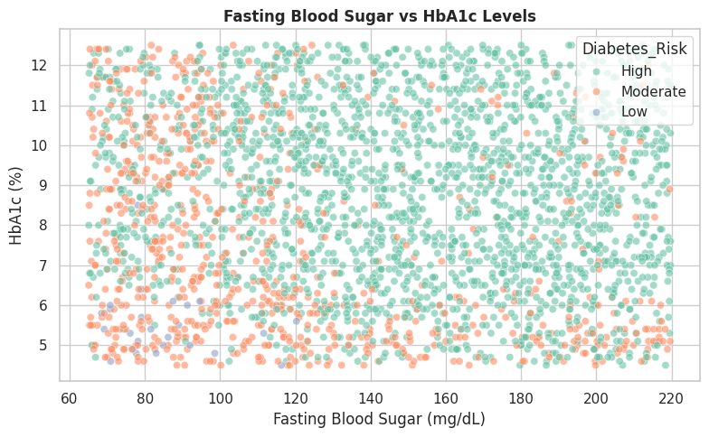
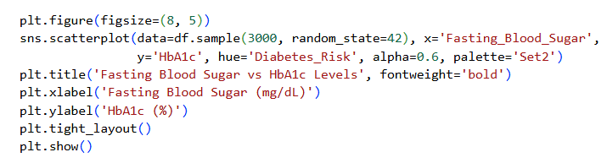
ANALYSIS & VISUALIZATION · Q4
What is the relationship between fasting blood sugar and HbA1c?
Key Insights
High risk points (green) cluster in the higher HbA1c range across nearly the full FBS range.
Moderate risk points (orange) concentrate more at lower HbA1c values.
No strong direct linear relationship appears between the two variables, but both independently relate to risk level.

Slide 20
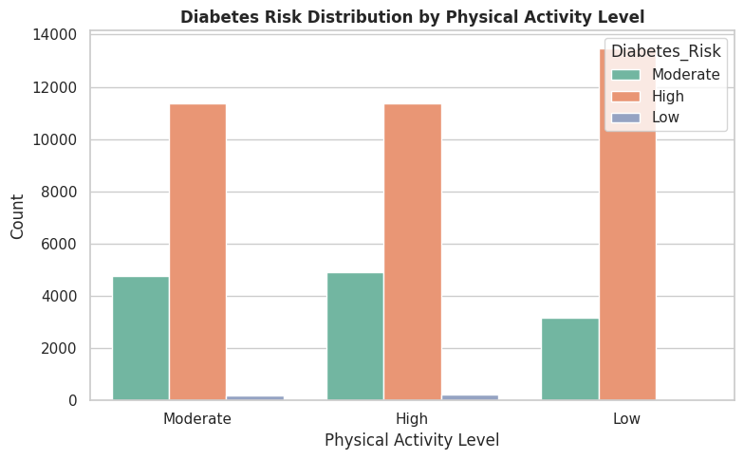
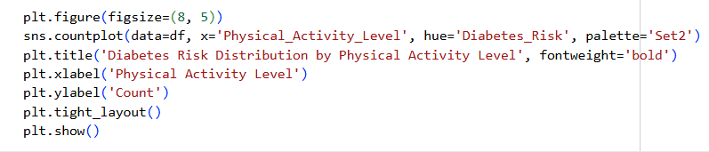
ANALYSIS & VISUALIZATION · Q5
Does the physical activity level affect the diabetes risk distribution?
Key Insights
Counts are fairly close across the three activity levels (Low / Moderate / High).
The High risk class remains dominant at roughly the same share in every activity level.
In this dataset, activity level alone does not appear as a strong distinguishing factor — it likely interacts with other variables.

Slide 21
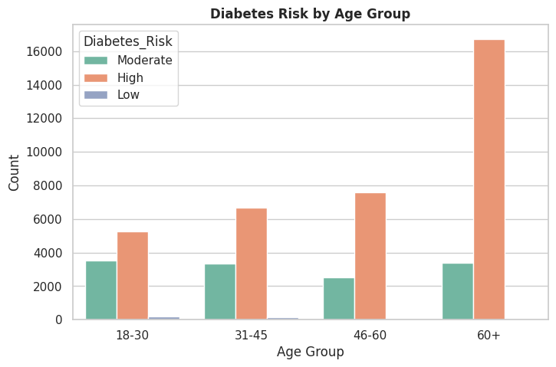
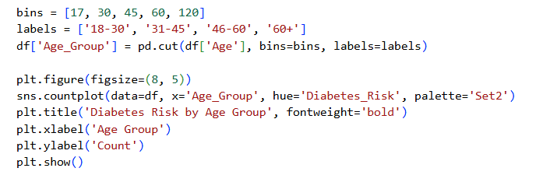
ANALYSIS & VISUALIZATION · Q6
How does diabetes risk change across age groups?
Key Insights
High risk case counts increase gradually with age, peaking in the 60+ group (~16,700 cases).
The Moderate risk class stays relatively stable across age groups.
Age emerges as a clear contributing factor to diabetes risk.

Slide 22
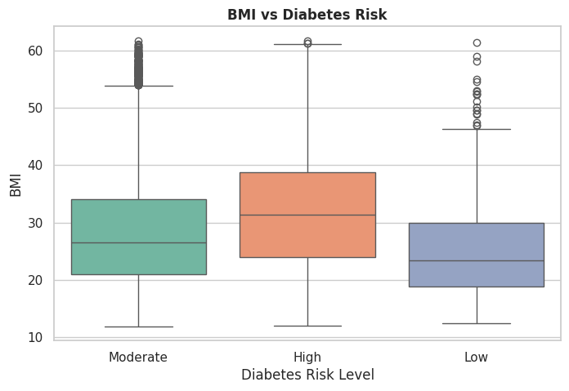
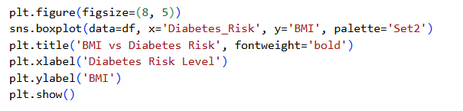
ANALYSIS & VISUALIZATION · Q7
What is the relationship between BMI and risk level?
Key Insights
Median BMI rises with risk level: ~23.5 for Low, ~26.5 for Moderate, and ~31.5 for High.
The High risk group also has the largest number of high BMI outliers.
Excess weight is clearly associated with higher diabetes risk.

Slide 23
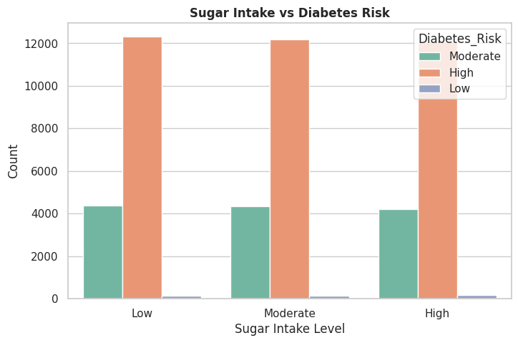
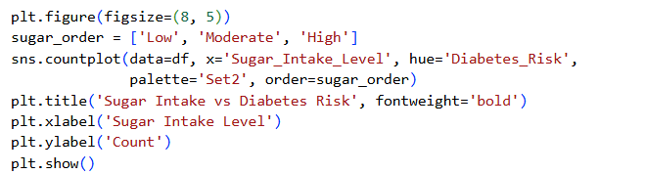
ANALYSIS & VISUALIZATION · Q8
Is sugar intake level related to diabetes risk?
Key Insights
The distribution is very similar across all three sugar intake levels.
The High risk class remains the majority at roughly the same share in every level.
As with activity level, sugar intake alone doesn't stand out as a strong distinguishing factor in this sample.

Slide 24
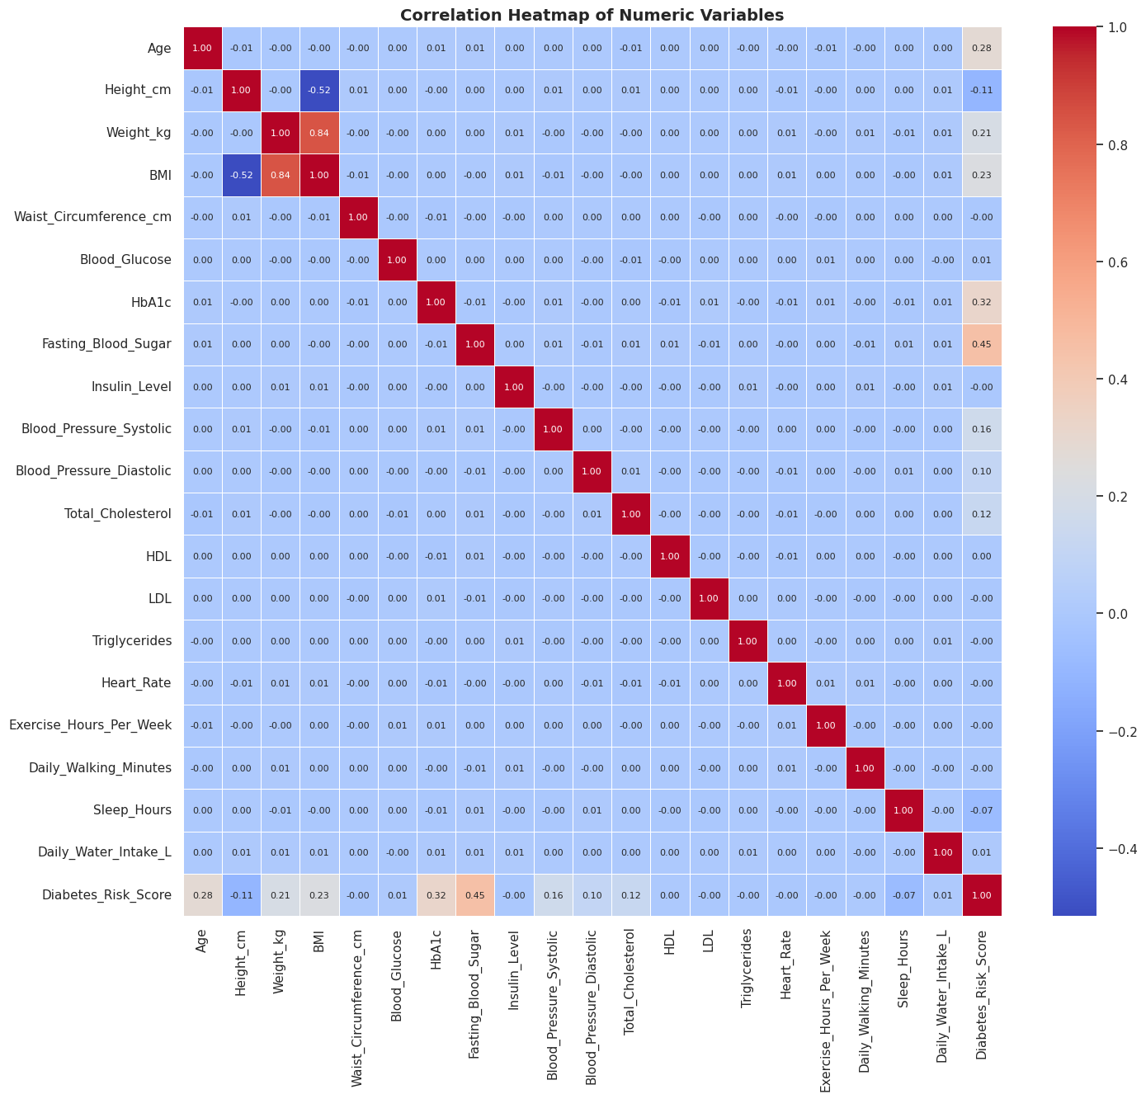
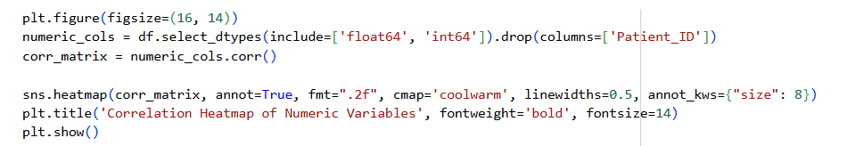
ANALYSIS & VISUALIZATION · CORRELATION
Correlation Heatmap of Numeric Variables
Strongest links to risk score
0.45
Fasting_Blood_Sugar
0.32
HbA1c
0.28
Age
0.23
BMI
0.21
Weight_kg
0.16
Blood_Pressure_Systolic
Sleep, exercise and daily water intake show almost no correlation with risk in this sample.

Slide 25

04
Health Recommendations
Practical tips to lower the risk of developing diabetes
Diabetes Risk Analysis

Slide 26






HEALTH RECOMMENDATIONS
Tips to Lower Diabetes Risk
Monitor blood sugar regularly
Maintain a healthy weight
Extra vigilance after 45
Track fasting blood sugar and HbA1c — the two strongest predictors of risk.
Lowering BMI is clearly associated with lower risk in the data.
Risk climbs gradually with age, especially after 60.
More frequent checkups with family history
Cut back on sugar and fat
Stay active and sleep well
Patients with a family history are more likely to fall in the High risk group.
Follow a balanced diet with less added sugar.
Regular exercise and healthy sleep support overall health and prevention.
Diabetes Risk Analysis

Slide 27
Thank You
Questions and discussion are welcome

